Slide 1
Section 0.4
“Before Calculus”: Inverse Functions; Inverse Trigonometric Functions

Slide 2
All graphics are attributed to:
Calculus,10/E by Howard Anton, Irl Bivens, and Stephen Davis
Copyright © 2009 by John Wiley & Sons, Inc. All rights reserved.

Slide 3
Inverse Functions
In everyday language the term “inversion” conveys the idea of a reversal.
Therefore, in mathematics, the term inverse is used to describe functions that reverse (undo) one another .
  f(x) = the original function
  f⁻╵(x)=the inverse function (NOT THE RECIPROCAL)
To find the inverse of a function, you must
  1. change f(x), if it is in the original, to y and
  2. interchange x and y,
  3. then solve for y.
  4. The result will be the inverse.

Slide 4
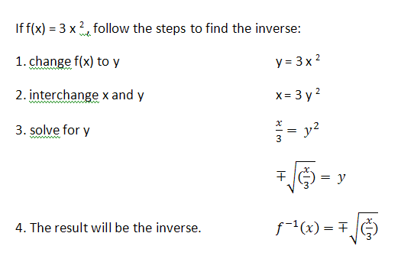
Inverse Example

Slide 5
Inverse Functions (con’t)
To prove algebraically that two functions are inverses of each other, you must show that f⁻╵(f(x))=x and that f(f⁻╵(x))=x.
See following slide for example.

Slide 6
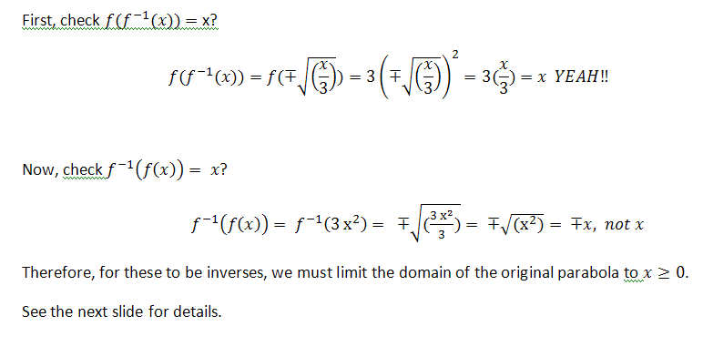
Example 4 from pg 41 in book

Slide 7
Inverse Functions (con’t)
Note: Sometimes, it is necessary to restrict the domain of an inverse f⁻╵(x)=x or of an original f(x) in order to obtain a function (see examples on page 44).
A function f(x) has an inverse iff it is one-to-one (invertible), each x has one y and each y has one x (must pass vertical and horizontal line tests). See next page for examples.

Slide 8

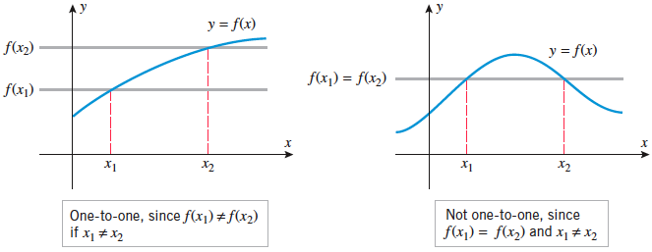

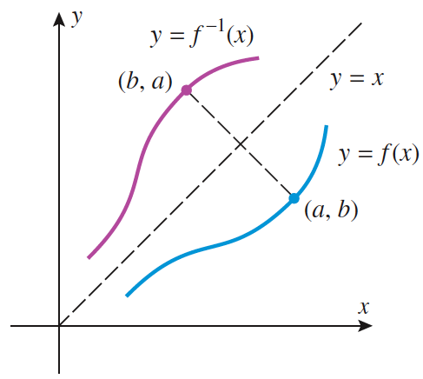
Inverse Functions (con’t)

Slide 9
Domain and Range of Inverse Functions
The domain of the inverse = the range of f(x)
The range of the inverse = the domain of f(x)
This should make sense because all of the points are just reversed between the original and the inverse.
Example: If f(x) = {(2,1),(3,3),(4,2),(5,7)}
then f⁻╵(x) = {(1,2),(3,3),(2,4),(7,5)}
You will use this idea to solve a problem or two on the section 0.4 assignment.

Slide 10
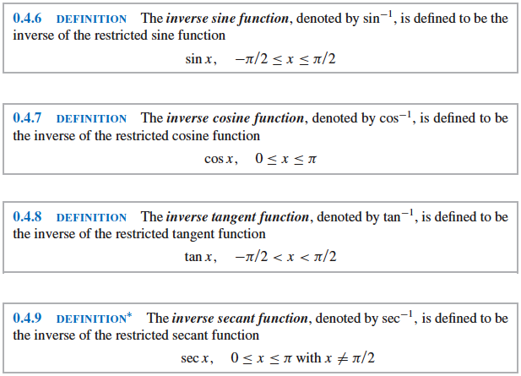
Inverse Trigonometric Functions
These are the definitions. Please see graphs on next page.

Slide 11
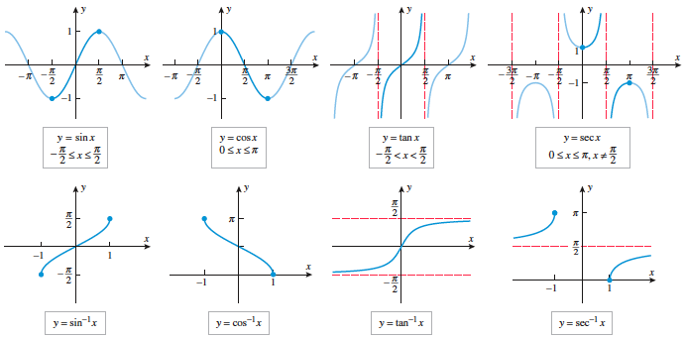
Graphs of Trig. Functions and Their Inverses

Slide 12
Evaluating Inverse Trig. Functions
Use the information from the unit circle to evaluate inverse trigonometric functions.
Example:
  Since cos (Π/3) = ½ , it is associated with the point (Π/3, ½).
  For inverse cosine, the point is reversed: (½, Π/3).
  To evaluate cos ⁻╵(½) you must find the angle whose cosine is ½. It just requires working backward.
  Answer: cos ⁻╵(½) = Π/3
  Make sure your answer is in the domain of inverse cosine (see slide #9) or you may have to pick an angle in a different quadrant. Remember All Students Take Calculus.

Slide 13
Identities for Inverse Trigonometric Functions
Please read pages 47 and 48 in your book and we will go through this part in class together.

